Slide 1
WICCI COUNCIL NAME (TYPE TEXT)
WOMEN´S INDIAN CHAMBER OF COMMERCE AND INDUSTRY
www.wicci.in

Slide 2
Council Vision &Mission
Create a platform providing financial advice, support and empowerment for women across all walks of life

Slide 3
Welcoming
Council Members to
WICCI
President, 14 Nominated Council Members

Slide 4
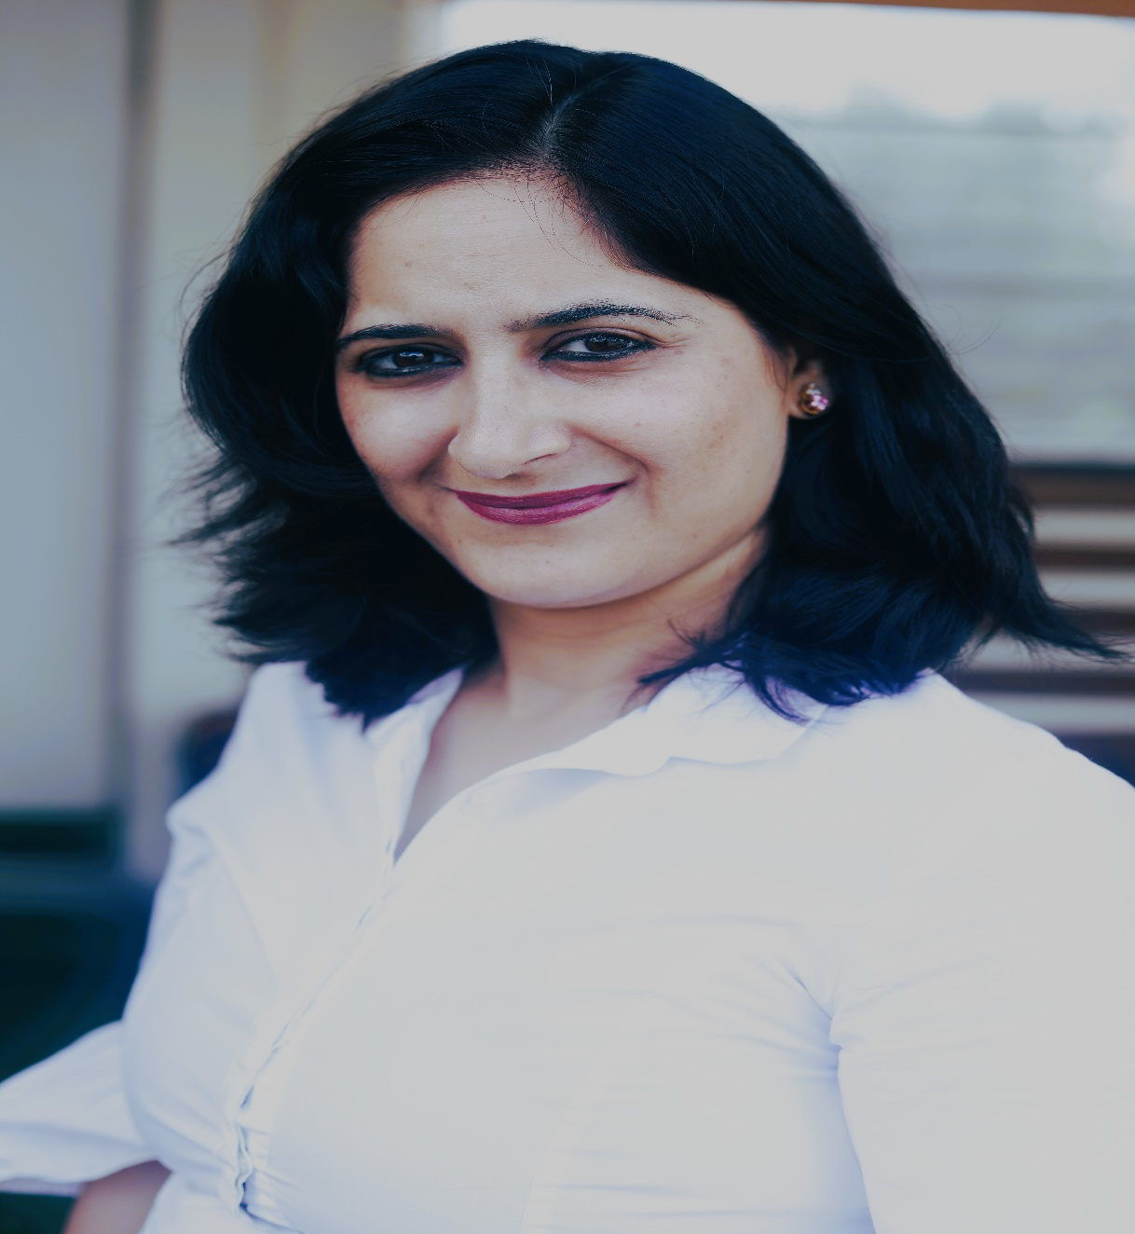
MARIA SHAH State President, BANKING AND CREDIT COUNCIL, Karnataka
Maria Shah is a Career Growth Coach and an NLP Practitioner, who has touched the lives of more than 6000 individuals till now. She is a Motivator and a Facilitator who is also associated with many International facilitation Communities.
She is also the Founder and Director of Infinite Mindset Consulting, which is an organisation which provides the relevant skills to the professionals in Corporate and also at an individual levels.
She has had a lustrous Corporate Career of 12 years across different MNCs. She believes that the only way to measure success is by creating an impact in the lives of individuals

Slide 5
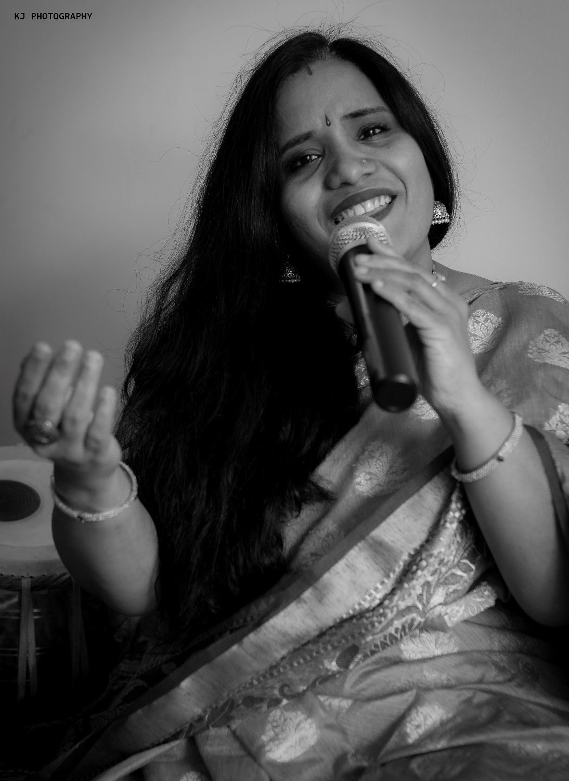
SUSHMA SANGHI COUNCIL MEMBER, BANKING AND CREDIT COUNCIL
Sushma Sanghi, is a Hindustani Classical Vocalist, a Performer and a Music Guru. She is trained from the prestigious Gwalior Darbhanga Gharana under Dhrupad Maestro Dr. Prashant Mallick.
She is Founder of Sanidha School of Music for Hindustani classical vocal and light music imparting training to children, adults and senior citizens.
She has trained more than 500 students in the Guru Shishya Parampara. Sanidha’s Annual Concert gives a stage to students to perform and discover their true potential. Sushma does kathak and writes poetry too.
She was a corporate trainer and has worked with many MNCs for more than a decade.
She is a dreamer and a doer!

Slide 6
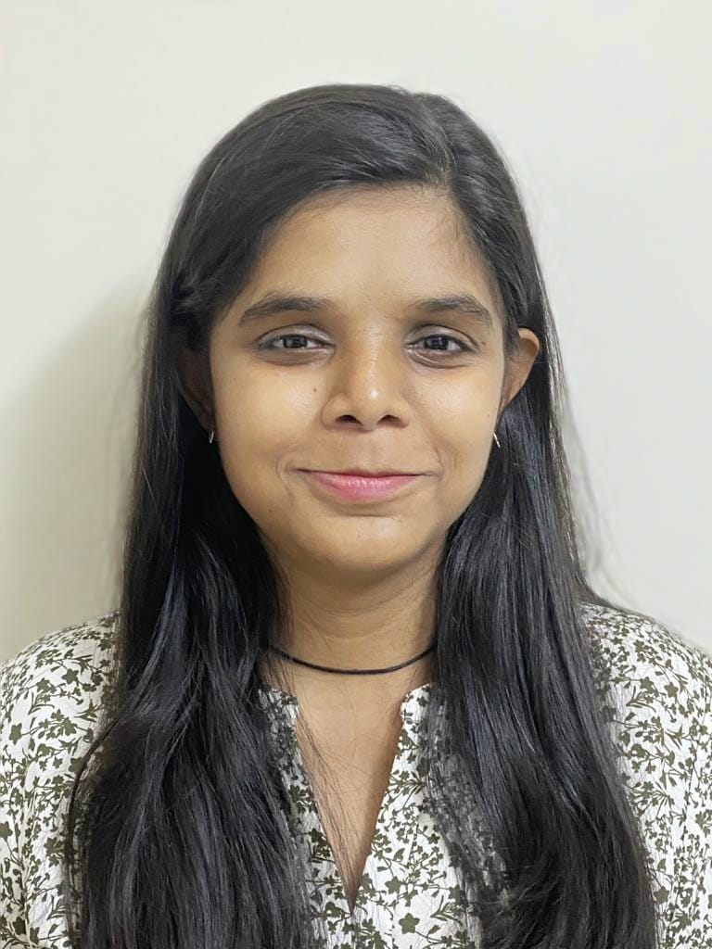
MANALI MISHRA Member Karnataka Chapter COUNCIL WICCI
Manali is working in credit field since last 7 years, from Credit Analysist to Credit Manager.
A simple little introvert girl who hardly managed to pass school exams, today as Credit Manager.
She loves learning new things, speaking to random unknown people and having fun.
Insert High Resolution Picture
Notes:
- Deleted
Happy and Single in her 30 also (an honestly I mean it//nothing against marriage)

Slide 7
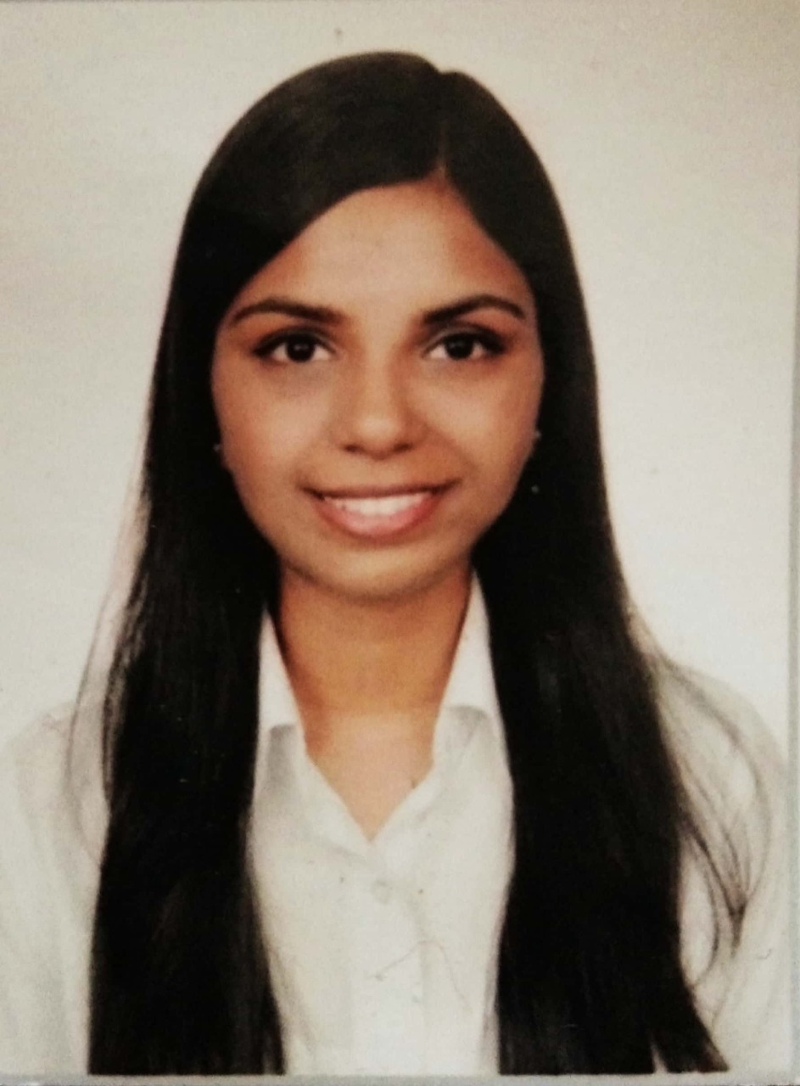
RITHIKA PANICKER
COUNCIL MEMBER, (BANKING & CREDIT )COUNCIL WICCI
BIO :-
Rithika Panicker is an experienced legal professional with extensive knowledge in the housing finance sector. She got her degree in BBA, LLB (Hons.) from Nirma University where she graduated in First Class with Distinction.
Rithika is presently working as a Credit Legal Manager at Sewa Grih Rin Limited. She has previously worked as a Legal Manager at Star Housing Finance Ltd. and also served as a Legal Consultant at Gujarat Industrial Development Corporation.

Slide 8
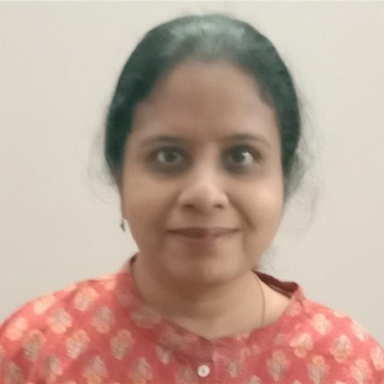
SAPNA BHARGAVA
COUNCIL MEMBER, (Karnataka )COUNCIL WICCI
BIO :-
Sapna is an IT professional with over 28 years of experience. She is currently working as Director – Technology in a reputed IT organization.
Insert High Resolution Picture

Slide 9
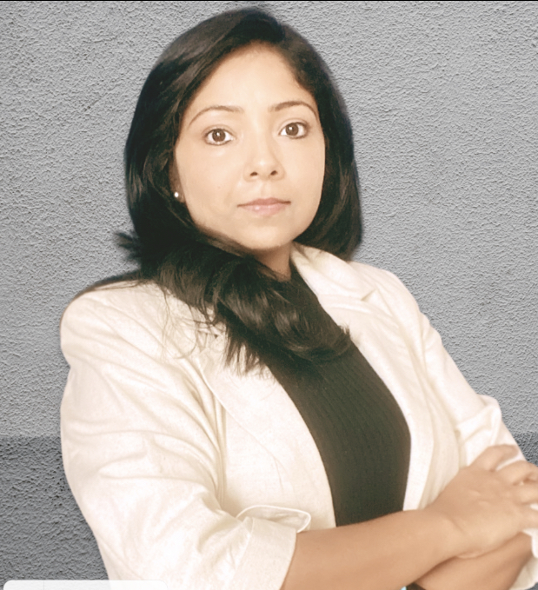
SWATI SINHA
COUNCIL MEMBER, (KARNATAKA)COUNCIL WICCI
BIO :-
Swati is founder of a women based organization ”Sakhiforlife” which is an all women platform.
Her aim is to bring and sustain more women into workforce.
She is also an accomplished career coach and work with mid-career women.
She comes with one and half decade of corporate experience in Banking and IT.

Slide 10
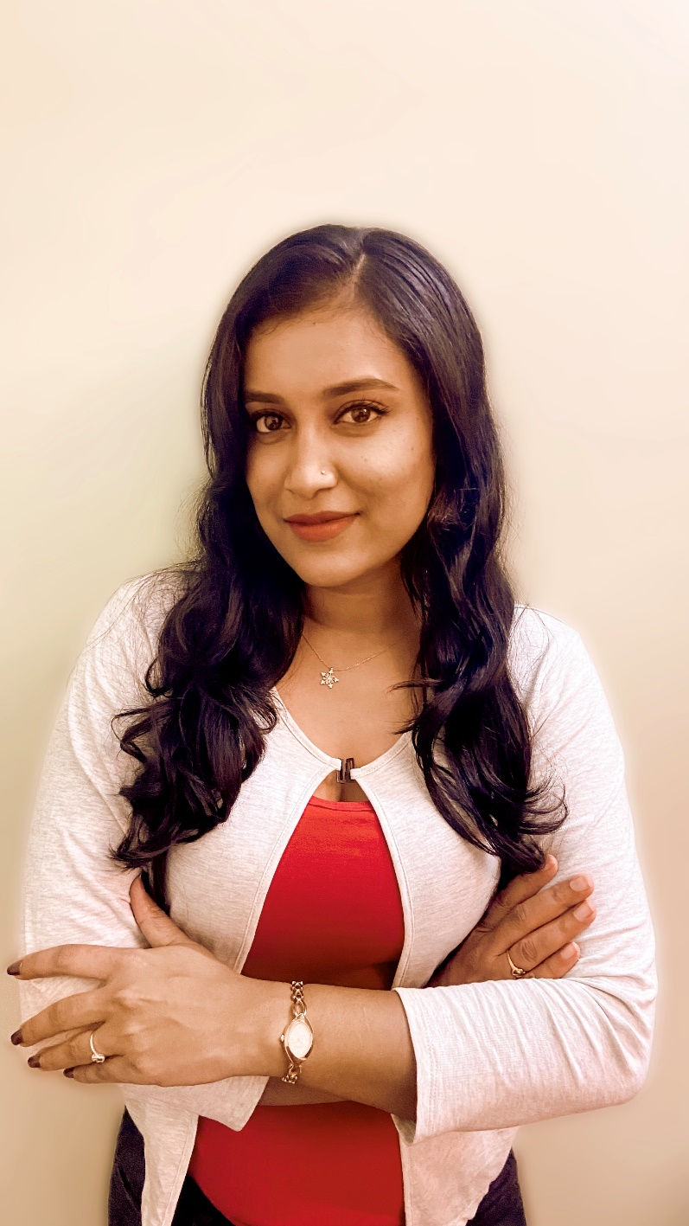
Lakshmi K
COUNCIL MEMBER, (Karnataka)COUNCIL WICCI
BIO :-
Laskhmi is first generation entrepreneur with a recruitment company called “Astra Source”.
Her focus is to provide the right job for deserving candidates and she believes in this cause.
She is an advocate on equal pay & equal opportunities for women at workplaces, which she is trying to fulfill through this venture.
Her interests are varied as a selenophile, avid photographer, studying numerology & love to travel.

Slide 11
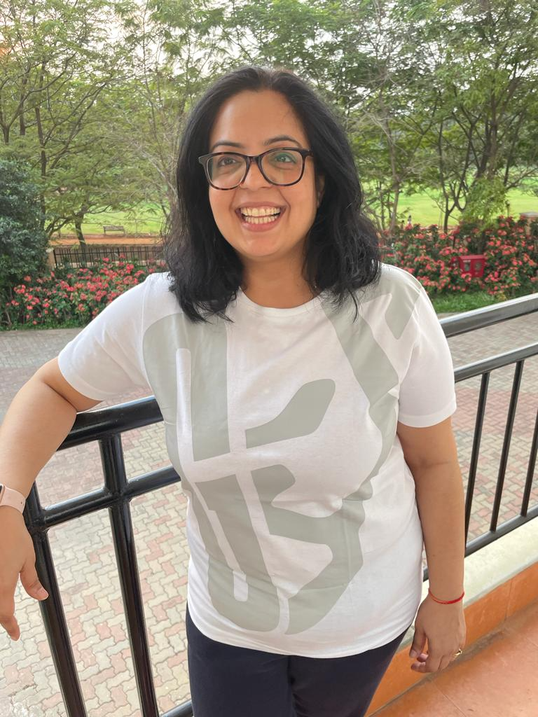
DR. DEEPIKA PONAPPA
COUNCIL MEMBER, Karnataka COUNCIL WICCI
Deepika is a MBBS physician turned Operations domain corporate leader.
She took the entrepreneurial dive and founded an athleisure apparel company Gripped which specializes in Compression wear.
She is an alumnus of the prestigious Indian School of Business, Hyderabad. Her first stint with healthcare operations began as she co-founded a chain of retail primary care clinics called Nationwide primary healthcare services. After this she worked in the operations domain at various reputed Indian healthcare orgs like HCL Healthcare & IKS health.
She is very passionate about seeing more women in leadership roles & serves as a mentor in various forums. As regards to gender diversity in corporates she is actively involved in policy making & has also served as a presiding officer in POSH committees of several organizations.

Slide 12
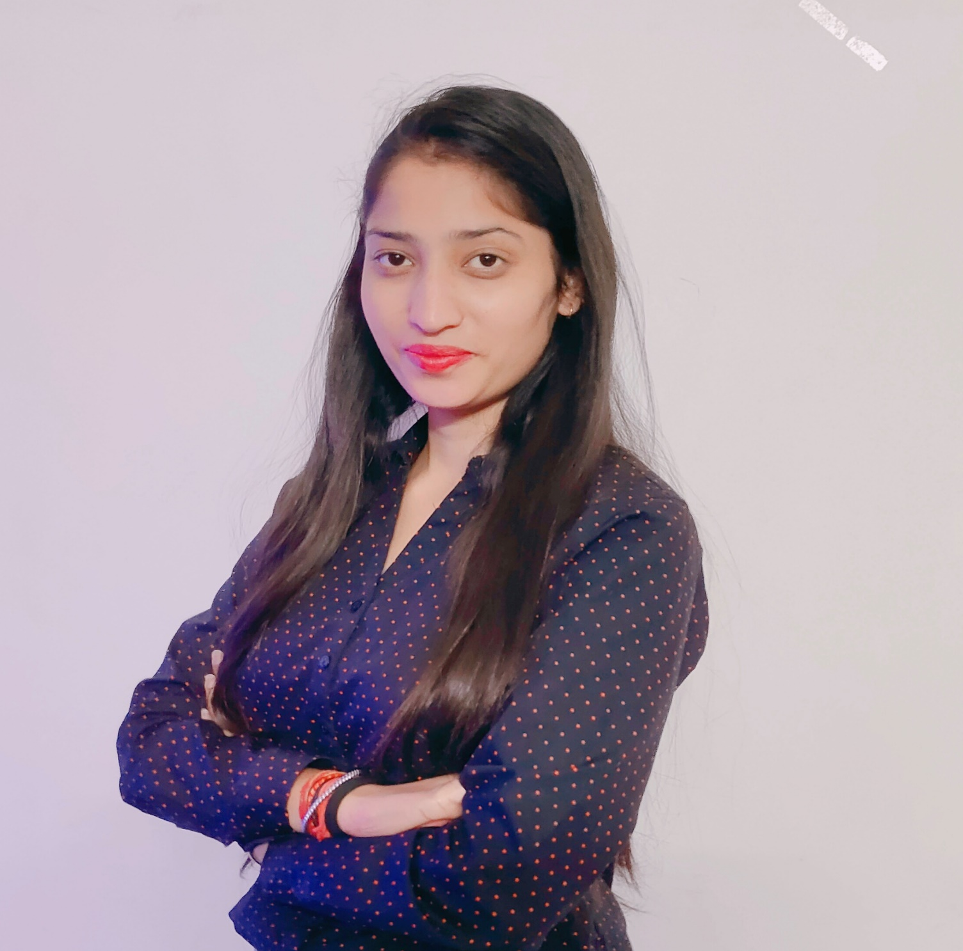
SAKSHI MALHOTRA
COUNCIL MEMBER, (Karnataka , Banking & Credit)COUNCIL WICCI
BIO :-
Sakshi Malhotra is a Service Manager with Wealth Management for Unified Vision Capital Pvt Ltd.
She has extensive experience as a Financial Service Manager and use that experience in bringing financial awareness among people (specially women's) .
She is passionate about her work and always have keen interest in understanding the financial status of the people and aware them about the various Investment which will bring them financial independence .
She is MA Economics and from the very starting her education, she was interested in understanding the financial independency level of the women and imparting the education on the same.
She is helping , guiding and bringing many women’s forward to gain financial independence.
Insert High Resolution Picture

Slide 13
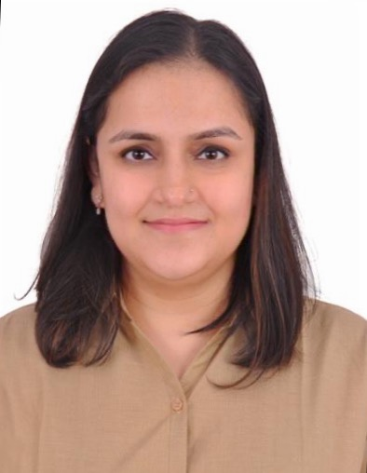
Lt Cdr (Dr) Ambika Nautiyal COUNCIL MEMBER, (Karnataka , Banking & Credit)COUNCIL
BIO :-
An Armed Forces Veteran turned Business Development Manager.
Upon graduation from AFMC, Pune, she started her professional journey as a doctor in various hospitals of Indian Navy in Mumbai as well as Defence Headquarters in New Delhi. After serving in the Indian Navy for 7 years, she hung her boots and started her corporate journey in a leading NBFC.
Having mentored various women to choose a career in the Armed Forces, she now seek this opportunity to continue promoting women from all walks of life to grow as professionals

Slide 14
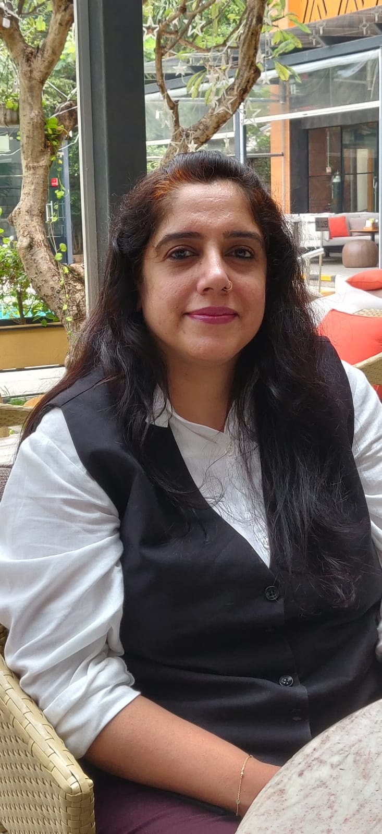
MHAK KALRA & WICCI DESIGNATION
BIO :-
Business Story Teller, Soft Skills Coach & Mentor Mehak Kalra is a certified Master Trainer NSDC and competent facilitator with more than 15 years of experience in the field of Learning & Development.
Her rich corporate experience from her clients like Bosch, Infosys, Page Industries, Wonder-La, Strategic Automation, SLK Software has helped her hone her skills to be one of the most popular and sought-after corporate trainers with the right amount of training fervor and knowledge-sharing. Her cross-industry experience ranging from Aviation, Travel Tourism, Hospitality to Retail, Manufacturing and Construction has added to her vast repertoire of facilitation and coaching skills.
Mehak Kalra has successfully completed Master Trainer Program NSDC, IIMB ‘Do your Venture’, an alumni of 10K women entrepreneurs Goldman Sach, Life Skills Certified from CDF London, She is also a certified Master Trainer with Bosch for Nation & Attitude Building, CCE ICF Coach certificate on Positive Psychology In addition, life time member at ISTD, are some of her other certifications of international repute and credibility.
Her strong belief in “Tell me and I forget, teach me and I may remember, involve me and I will learn” led her to apply experiential learning methodology that enhances overall training effectiveness. She is an avid learner and follower of ‘Experiential Learning’ discipline of pedagogy which believes any form of education should be ‘learning with Joy’ what is already there in each individual’s soul
Insert High Resolution Picture

Slide 15
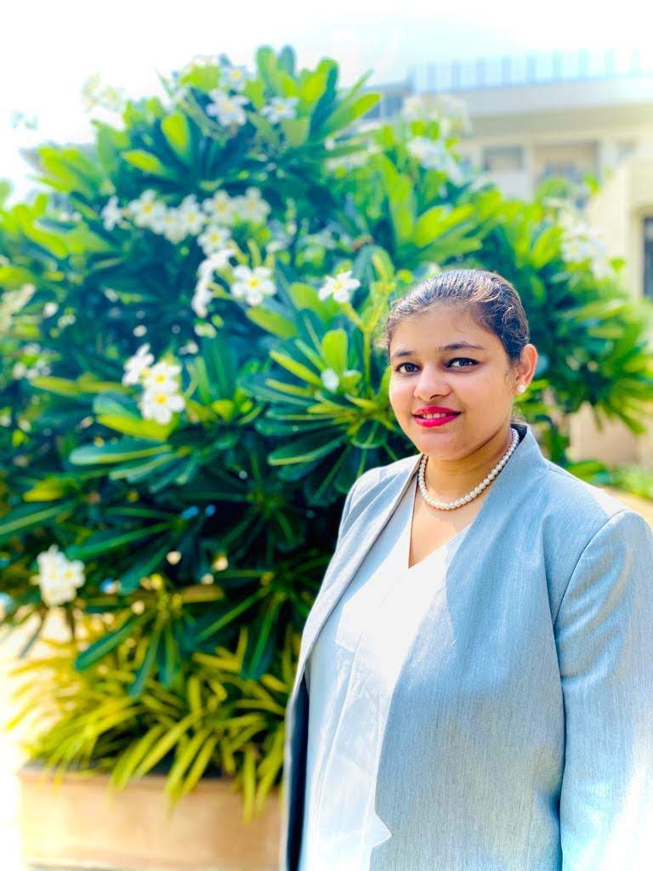
Nitisha Gupta & WICCI DESIGNATION
Council member, COUNCIL WICCI
BIO :-
Teacher, A Leader, A Social Worker, A Dancer and A story Teller. An Educationist with 11+ years of experience of teaching and administration.

Slide 16
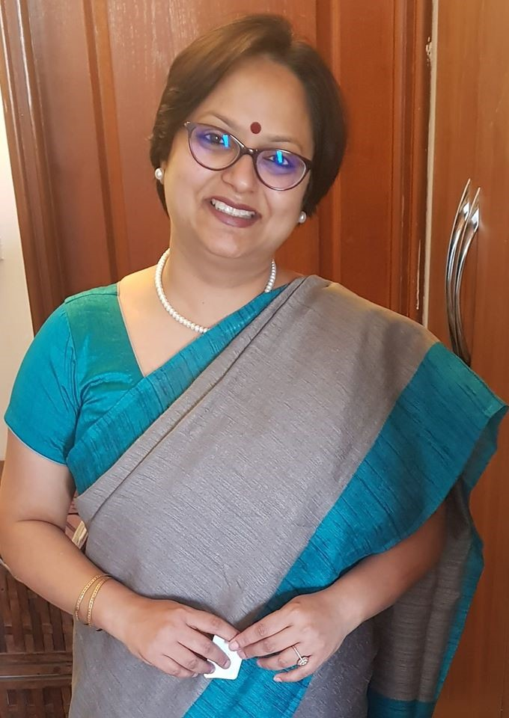
Sujatha Singh & WICCI DESIGNATION
COUNCIL MEMBER, (Karnataka )COUNCIL WICCI
BIO:-
PRODUCTIVITY COACH(ICF)|MOTIVATIONAL SPEAKER|STORYTELLER|LEADERHIP TRAINER|SUPERSPEAKER TOP 1000 (Success Gyan’s Reality Show Season 2|PUBLIC SPEAKING COACH|YOUTUBER

Slide 17
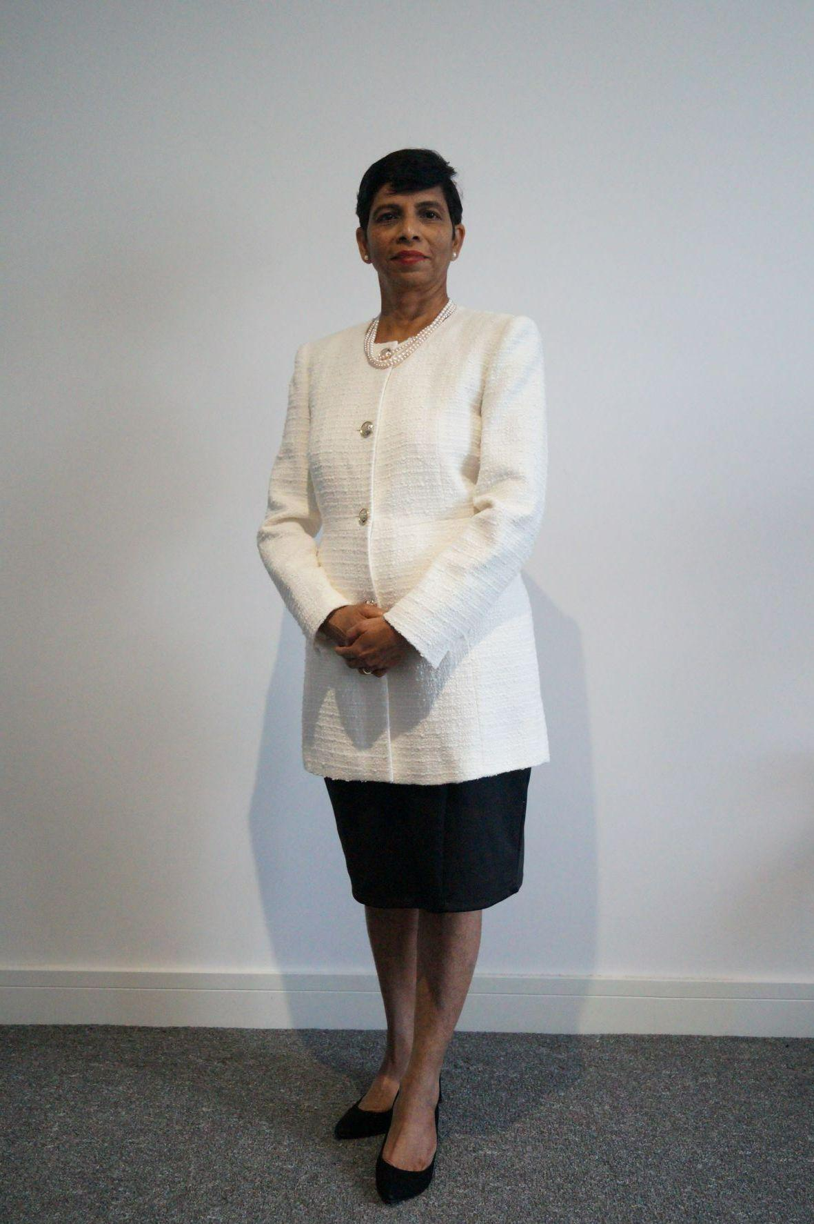
Maria Pontes & WICCI DESIGNATION
COUNCIL MEMBER, (…………. )COUNCIL WICCI
Maria Pontes is a BA Graduate with PGDHRM. Ended a professional journey with NIIT Ltd after 4 decades journey from being a Stenographer to HR Manager. During the 2020 lockdown, she published her first book titled ‘Realms of Dreams’. Her co-authored book is shortly to be published.
She is the Past All India President of the Indian Association of Secretaries & Administrative Professionals (IASAP). Has had the opportunity of traveling to Singapore, Malaysia, Hongkong, Pakistan & Papua New Guinea.
As a Coach, Maria reinvented a Retirement Lifestyle planning for herself. Today she is on a mission to help Women planning to retire or retired to Reinvent a Retirement Lifestyle for Legacy in a most graceful way where their entire life is taken care of.
Insert High Resolution Picture
Notes:
Deleted –
Maria has happily retired by ending one career and starting the next.
You can connect with her at :
LinkedIn: maria-pontes-803b58200
IG topcoachmaria/
YouTube channel/UCnVp5oXTT1Z6cD7MyhkYNcw
FB maria.pontes.58726
email coachmariapontesinfo@gmail.com

Slide 18
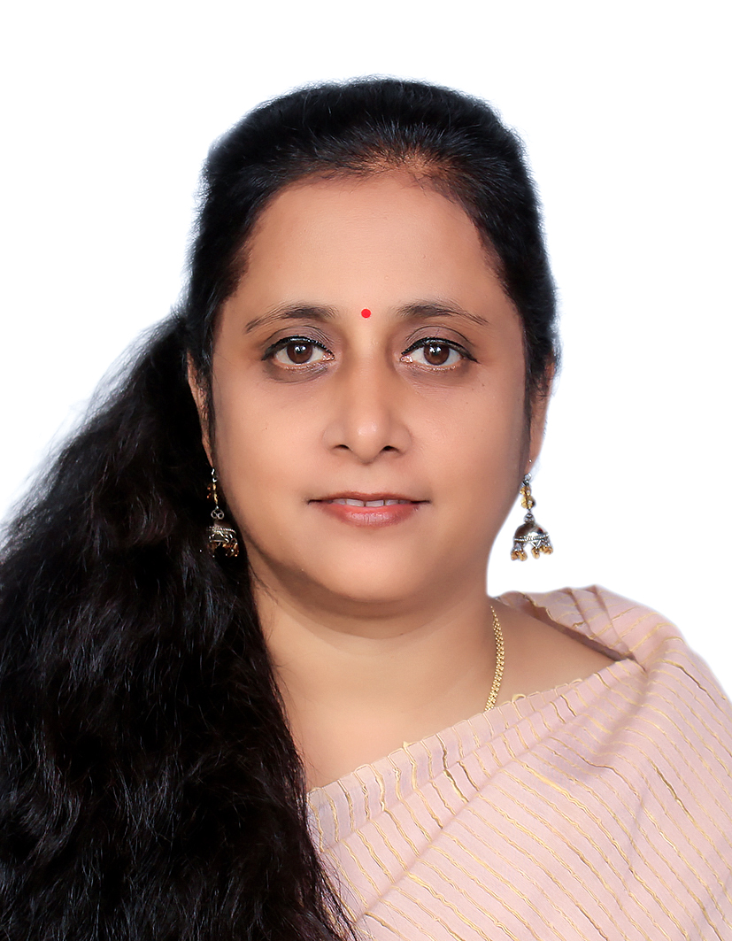
TYPE NAME & WICCI DESIGNATION
COUNCIL MEMBER, (Karnataka…………. )COUNCIL WICCI
Dr. M. S. Devi Assistant Professor , Department of Commerce-Shiv Nadar University, Chennai.
Dr Devi is an experienced Finance Faculty/Professional with a Doctorate in the area of Corporate Mergers & Acquisitions. She brings a blend of teaching and industry experience.
Her vast industry experience includes job profiles both in Manufacturing and Service industry for a period of nine years. She has written research papers/ Book chapters and published ET cases for Management students.
Dr. Devi is very passionate in mentoring and contribution to the community. She is an active contributing writer for MarketExpress, Inc., a global insights and analysis sharing platform. She is also a regular Guest speaker for Graduate Commerce students at other Mumbai based colleges.
Insert High Resolution Picture

Slide 19
TYPE NAME & WICCI DESIGNATION
COUNCIL MEMBER, (…………. )COUNCIL WICCI
BIO :-
Type Text
Insert High Resolution Picture

Slide 20
TYPE NAME & WICCI DESIGNATION
COUNCIL MEMBER, (…………. )COUNCIL WICCI
BIO :-
Type Text
Insert High Resolution Picture

Slide 21
TYPE NAME & WICCI DESIGNATION
COUNCIL MEMBER, (…………. )COUNCIL WICCI
BIO :-
Type Text
Insert High Resolution Picture

Slide 22
TYPE NAME & WICCI DESIGNATION
COUNCIL MEMBER, (…………. )COUNCIL WICCI
BIO :-
Type Text
Insert High Resolution Picture

Slide 23
TYPE NAME & WICCI DESIGNATION
COUNCIL MEMBER, (…………. )COUNCIL WICCI
BIO :-
Type Text
Insert High Resolution Picture

Slide 24
TYPE NAME & WICCI DESIGNATION
COUNCIL MEMBER, (…………. )COUNCIL WICCI
BIO :-
Type Text
Insert High Resolution Picture

Slide 25
TYPE NAME & WICCI DESIGNATION
COUNCIL MEMBER, (…………. )COUNCIL WICCI
BIO :-
Type Text
Insert High Resolution Picture

Slide 26
TYPE NAME & WICCI DESIGNATION
COUNCIL MEMBER, (…………. )COUNCIL WICCI
BIO :-
Type Text
Insert High Resolution Picture

Slide 27
TYPE NAME & WICCI DESIGNATION
COUNCIL MEMBER, (…………. )COUNCIL WICCI
BIO :-
Type Text
Insert High Resolution Picture

Slide 28
TYPE NAME & WICCI DESIGNATION
COUNCIL MEMBER, (…………. )COUNCIL WICCI
BIO :-
Type Text
Insert High Resolution Picture

Slide 29
TYPE NAME & WICCI DESIGNATION
COUNCIL MEMBER, (…………. )COUNCIL WICCI
BIO :-
Type Text
Insert High Resolution Picture

Slide 30
TYPE NAME & WICCI DESIGNATION
COUNCIL MEMBER, (…………. )COUNCIL WICCI
BIO :-
Type Text
Insert High Resolution Picture

Slide 31
TYPE NAME & WICCI DESIGNATION
COUNCIL MEMBER, (…………. )COUNCIL WICCI
BIO :-
Type Text
Insert High Resolution Picture

Slide 32
TYPE NAME & WICCI DESIGNATION
COUNCIL MEMBER, (…………. )COUNCIL WICCI
BIO :-
Type Text
Insert High Resolution Picture

Slide 33
TYPE NAME & WICCI DESIGNATION
COUNCIL MEMBER, (…………. )COUNCIL WICCI
BIO :-
Type Text
Insert High Resolution Picture

Slide 34
SUPPORTED BY
WICCI is supported by the massive global networks of ALL Ladies League (ALL), Women Economic Forum (WEF), and SHEconomy.
ALL is a movement of ‘Sisters Beyond Borders.’
WEF is a platform for ‘Business Beyond Borders.’ SHEconomy is e-commerce for women worldwide in Goods & Services for ‘Commerce Beyond Borders’

Slide 35
COUNTRIES REPRESENTED
Albania, Angola, Armenia, Argentina, Australia, Azerbaijan, Bangladesh, Brazil, Burundi, Cameroon, Canada, Chad, China, Costa Rica, Croatia, Cyprus, Czech Republic, Colombia, Ecuador, Egypt, Ghana, Germany, Greece, Guatemala, Hong Kong, Hungary, India, Italy, Israel, Ireland, Japan, Kazakhstan, Kenya, Kyrgyzstan, Lesotho, Luxembourg, Malawi, Malaysia, Mexico, Moldova, Monaco, Montenegro, Morocco, Mozambique, Malta, Netherlands, Nigeria, Nepal, New Zealand, North Macedonia, Norway, Paraguay, Portugal, Peru, Puerto Rico, Philippines, Qatar, Romania, Russia, Rwanda, Serbia, Singapore, Slovenia, Spain, South Africa, South Korea, Suriname, Sweden, Switzerland, Syria, Tunisia, Turkey, Uganda, Ukraine, UK, Uruguay, Venezuela, Vietnam, Virgin Islands (US), UAE, USA, Uzbekistan, Zimbabwe.

Slide 36
WOMEN'S INDIAN CHAMBER OF COMMERCE ANDINDUSTRY

